Slide 1
Site Selector Survey Analysis

Slide 2


Who are the site selectors?
Vision:
Guide corporate location decision and strategy
Function:
Uses natural forces to indicate a standard (True North), enabling the user to know where they are and where they are going

Slide 3




What is the “True North” standard for the site selectors?
Where is Utah positioned on the compass?
Where are other sites positioned on the compass?
How does 2016 Utah compare to 2017 Utah?

Slide 4

Site Selector Preferences - Influencers
Strong
Labor Quality
Labor Availability & Costs
Business Friendly Government
Weak
Quality of living
Construction costs
Population

Slide 5
Site Selector Preferences – Soft Factors
Important
Arts & Entertainment
Air Quality
Diversity
Not Important
Marijuana laws
Alcohol laws

Slide 6






Where does Utah stand? – Industry Association
Financial Services
Energy & Natural Resources
Life Sciences
Manufacturing
Customer Support
Data Centers

Slide 7
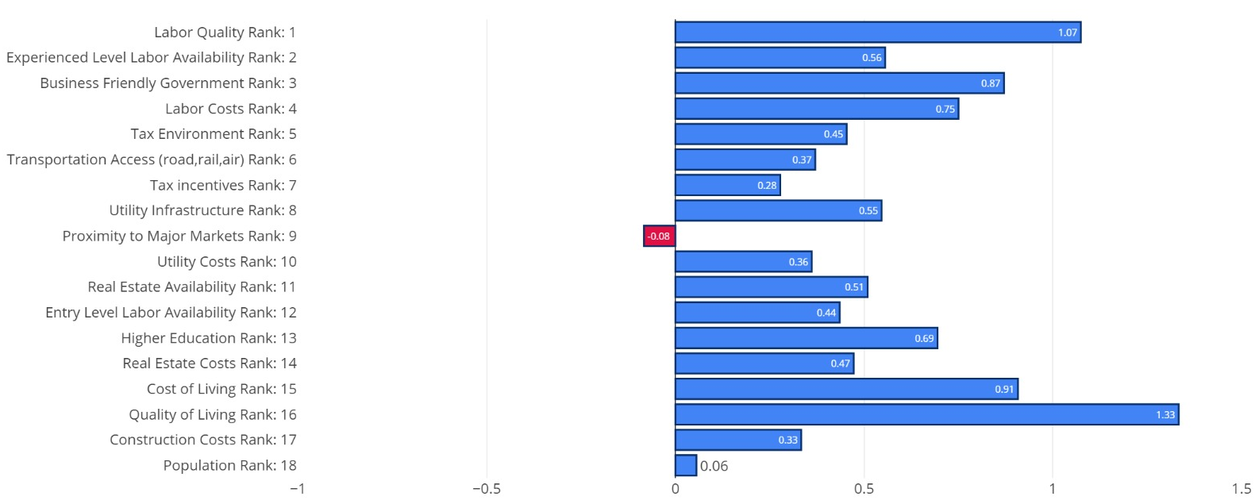
Where does Utah stand? – Top Influences

Slide 8


Utah’s Tax Program
Relative Performance
28% 52% 20%
What site selectors want?
Longer terms ( 20+ years )
Higher percentage rebates ( 30%+ )
Assessed valuation caps
Offer up-front cash
Free-in-lieu-of-tax programs

Slide 9
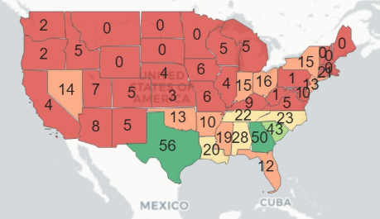
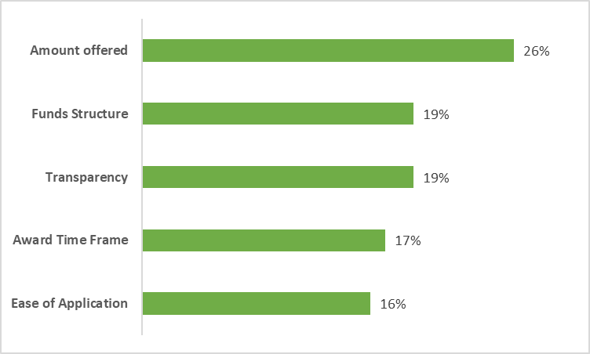
The Competition’s Tax Incentives
TX, GA, SC
Texas’ tax programs

Slide 10
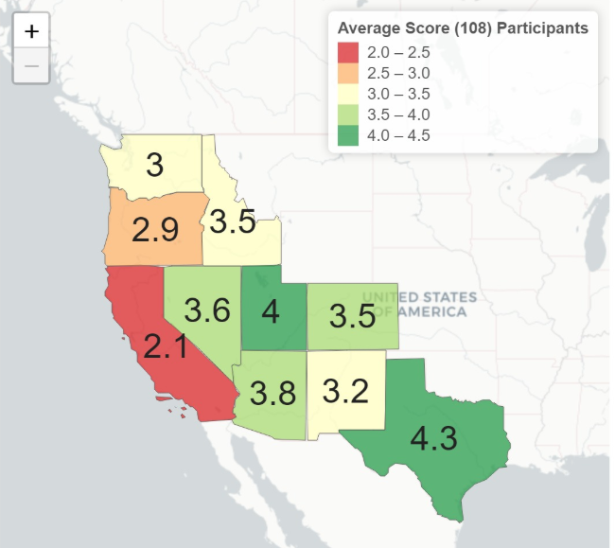
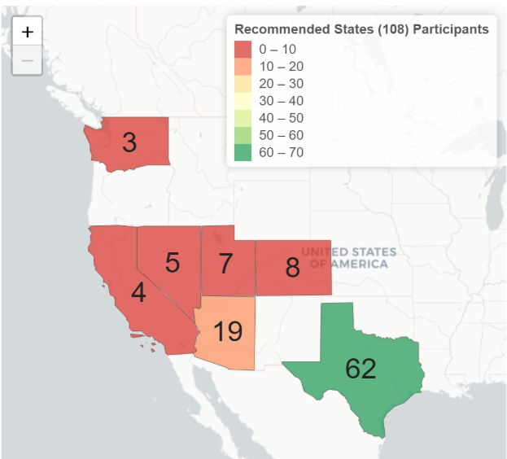
The Competition
Business Climate
Recommended States

Slide 11
2016 v 2017 – NPS changes
38 Common IPs
15 16 7
Negative
Detractors up by 3
Promoters down by 4
Positive
6 Detractors to Passive
3 Detractors to Promoters
6 Passive to Promoters

Slide 12
2016 v 2017 – Influencer strengths
No significant change in Cost of Living, Construction Costs, Quality of Life

Slide 13





Conclusions
Labor, Business Climate, Quality of Life
Financial Services, Life Sciences, Energy Resources
Tax Incentives, Transport & Major markets proximity
Manufacturing, Customer Support, Data centers
Texas biggest competitor
Arizona closest competitor
Review change in perceptions of site selectors
Explore opportunities in manufacturing, data centers
Focus on tax incentives, transport and real estate

